Slide 1
Inventory Management System
INFO 5100
Breeze Patel - 002821278 Vitan Tarpara - 002815476 Neel Desai - 002201416 Vedant Ukride - 002206626 Rutul Patel - 002697555

Slide 2
Introduction
The Inventory Management System in Java, a robust solution designed to streamline and optimize inventory operations through the implementation of CRUD functionality. In the dynamic landscape of modern business, efficient management of stock and assets is crucial for success. This project addresses the shortcomings of traditional inventory systems by harnessing the power of Java programming, providing a scalable and user friendly application. Join us as we delve into the ecosystem, explore the identified problems, unveil the system architecture, showcase key features, and demonstrate the seamless CRUD operations. Through this presentation, we aim to illustrate how our solution contributes to enhanced productivity, real time tracking, and a more responsive approach to inventory management challenges.

Slide 3
Problem Statement
In the current landscape of inventory management, traditional systems often grapple with inefficiencies, inaccuracies, and time consuming processes. Manual tracking methods and disparate data sources contribute to errors, leading to stockouts, overstock situations, and operational bottlenecks. The lack of a centralized and automated solution not only hinders the real time visibility of inventory but also impedes the adaptability needed in dynamic business environments. Recognizing these challenges, our Inventory Management System in Java aims to address these pain points by introducing a digitalized platform with CRUD capabilities, providing a comprehensive and efficient solution for organizations seeking to optimize their inventory control processes.

Slide 4
Requirement Specification
Hardware requirements:
Processor: Dual core processor or higher for optimal performance.
Memory (RAM): Minimum 4 GB RAM, recommended 8 GB for larger datasets.
Storage: 50 MB of free disk space for the application installation.
Display: 1024x768 resolution or higher for a better user interface experience.
Network: Stable internet connection for real-time updates and cloud integration.
Software requirements:
Operating System: Windows 10, macOS, or Linux for compatibility.
Java Runtime Environment (JRE): Version 8 or later for running Java applications.
Database: MySQL or any compatible relational database management system for data storage.
IDE (Integrated Development Environment): Netbeans for Java development.
Web Browser: Latest versions of Chrome, Firefox, or Safari for optimal web based functionalities.

Slide 5
System Design
The system design of our Inventory Management System revolves around a modular and scalable architecture, ensuring flexibility and adaptability to diverse business needs. The application utilizes a Java based backend for robust data processing and leverages a relational database, such as MySQL, to store and retrieve information efficiently. The user interface is designed for intuitive navigation, employing JavaFX for a responsive and user-friendly experience. The system incorporates CRUD operations, enabling users to seamlessly Create, Read, Update, and Delete inventory entries. The web based components are optimized for cross browser compatibility, allowing access from various platforms. Overall, our system design aims to deliver a cohesive, efficient, and user centric solution for streamlined inventory management.

Slide 6
System Model
The system model for our Inventory Management System is the design paradigm ensures a clear separation of concerns, with the Model responsible for data management and business logic, the View handling the user interface and presentation, and managing user input and system behavior. This approach enhances maintainability and extensibility, facilitating future updates or modifications. The system emphasizes modularity, allowing for the easy integration of new features or components. Additionally, it supports a responsive and interactive user experience through the incorporation of event driven programming, ensuring a seamless and efficient interaction between users and the inventory management functionalities.

Slide 7
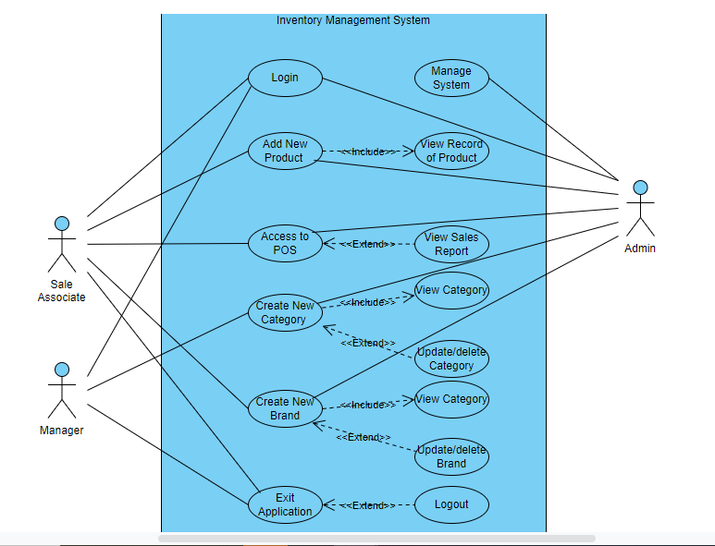
Use case Diagram

Slide 8
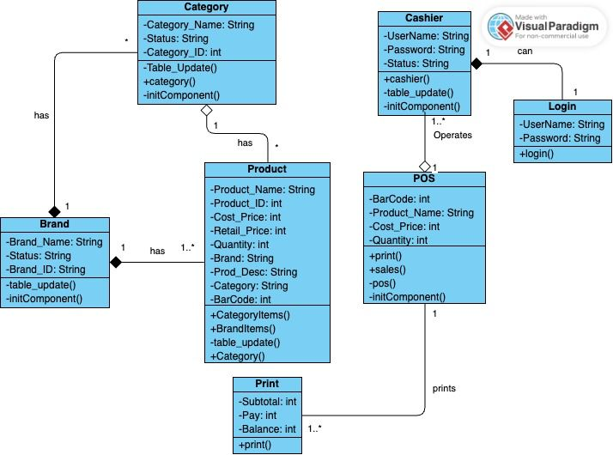
UML Class Diagram

Slide 9
Summary
In conclusion, our Inventory Management System in Java stands as a robust and adaptable solution addressing the inherent challenges of traditional inventory management. By seamlessly integrating CRUD operations into a well designed system architecture, we have created a tool that not only enhances operational efficiency but also provides real-time insights for informed decision making. The user friendly interface, coupled with scalable and modular design principles, ensures the system's relevance and flexibility in dynamic business environments. As we look ahead, the application holds the potential to revolutionize how organizations manage their inventory, paving the way for streamlined processes, reduced errors, and heightened productivity in the ever evolving landscape of business operations.

Slide 10
Thank You

